Slide 1
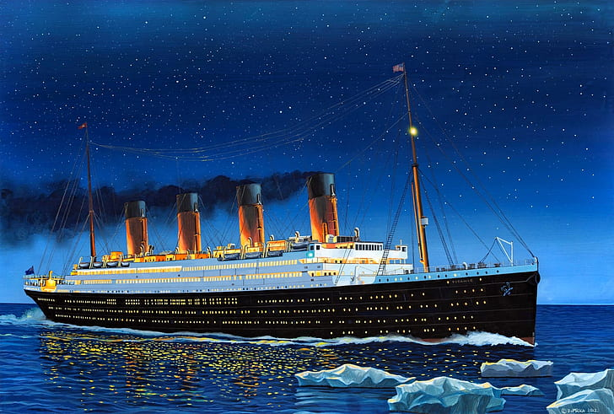
EXPLORATORY DATA ANALYSIS REPORT
SURVIVAL ANALYSIS
Uncovering Survival Patterns: How Class, Gender, and Fare Shaped the Fate of Titanic Passengers
TITANIC SNS INBUILD DATASET

Slide 2
INTRODUCTION
Introduction to the Dataset
The dataset analyzed in this report originates from the well-known Titanic disaster, which occurred on April 15, 1912. It provides detailed information about the passengers aboard the Titanic, including their demographics, socio- economic status, and survival outcomes. The dataset contains 891 rows and 15 columns, with each row representing a unique passenger.
Purpose of Analysis
The purpose of this analysis is to explore the dataset and uncover patterns and trends related to survival, passenger demographics, and socio-economic factors. The insights derived from this analysis can be useful for understanding the factors that influenced survival during the Titanic disaster.

Slide 3
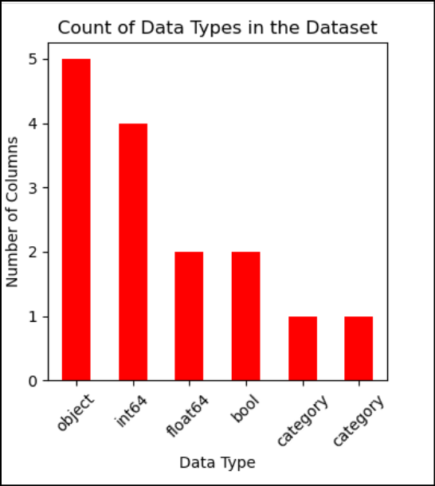
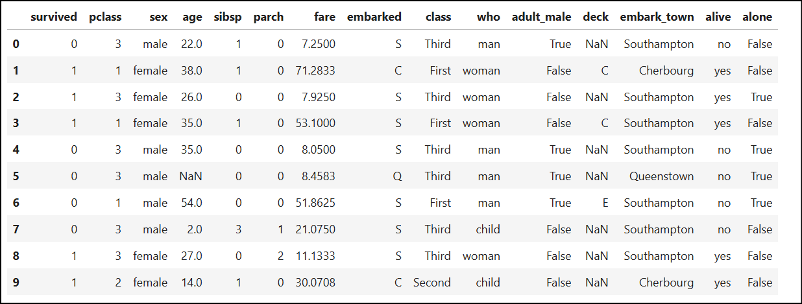
DATA structure
Columns overview:
Total columns: 15
Numerical columns: 6
2 categorical-based: survived, pclass
4 with numerical impact
Boolean columns: 2
Object columns: 5
Category columns: 2

Slide 4
Data Quality and Insights:
Redundant Columns:
adult_male: Redundant, as gender and who can determine adult males.
alive: Redundant, as survived provides the same information.
class: Redundant, as pclass captures class status.
embarked or embark_town: Both represent the same data; only one is necessary.
alone: Redundant, as the combination of sibsp and parch indicates whether a passenger is alone.
NULL VALUES:
age: 714 non-null values(missing~17 values
embarked and embark_town: 889 non-null values (~2 missing)
Deck: 203 non-null values(highly incomplete)

Slide 5
Passenger Demographics, Class Distribution, and Survival Overview
* Total Passengers were 891.
* On that, number of adult male passengers were 537, number of adult female passengers were 271 and number of children were 83.
* The passenger distribution across classes shows that the Third Class had the highest proportion of passengers at 55%, followed by First Class with 24%, and Second Class with 21%. This indicates a significant majority of passengers belonged to the lower socio-economic group.
* The majority of passengers, 72.28%, embarked from Southampton, followed by 18.86% from Cherbourg, and the remaining 8.64% from Queenstown. This highlights Southampton as the primary departure point for the Titanic's journey.
* 39 % of people were survived and 61% of people were dead.

Slide 6
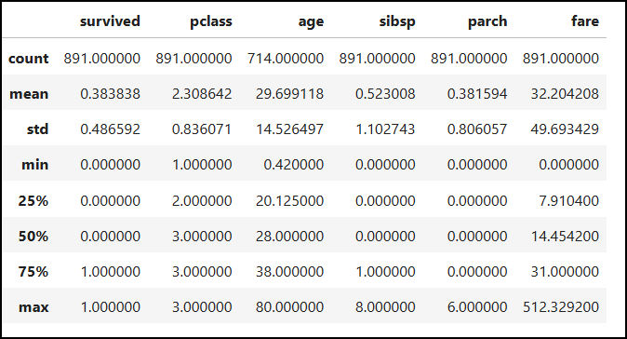
Statistical Summary of Passenger Attributes
* The age of passengers ranged from a minimum of 0 to a maximum of 80, with an average age of 29 years.
* The number of siblings/spouses (sibsp) aboard ranged from 0 to 8, with the maximum number of 8 being unusually high.
* The number of parents/children (parch) ranged from 0 to 6, with the highest being 6.
* The fare paid by passengers varied from 0 to 512.33, with an average fare of 32.20, indicating a wide range in ticket prices.

Slide 7
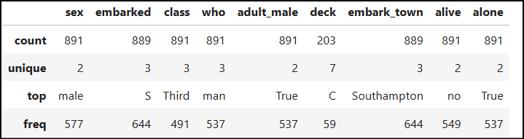
Categorical Summary
Sex: Male dominated.
Embarked: Mostly Southampton.
Class: Majority in Third Class.
Who: Predominantly Men.
Adult_Male: Mostly Adults.
Deck: Sparse data, mostly Deck C.
Embark_Town: Largely Southampton.
Alive: Majority did not survive.
Alone: Mostly traveled alone.

Slide 8
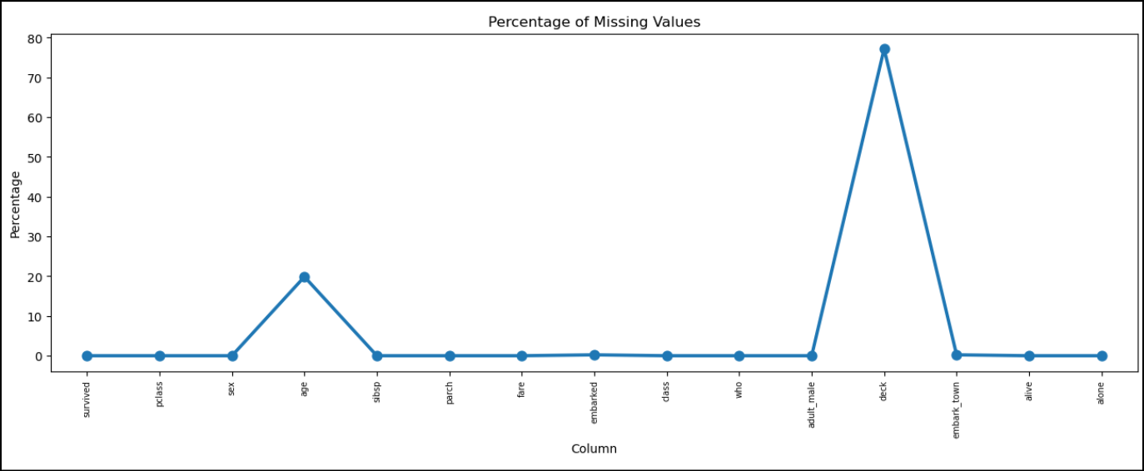
Missing Data Analysis:
Deck has 77% of null values
Age has 19.8% of null values
embarked and embark_town, both has 0.22 % of null values, which will not impact majorly. So, no need of imputing.
Since deck has more than 70% of missing values and it has no catch over other columns, dropping deck column is a wise one.
Imputing missing values on deck may affect the impact of analysis.
Only age column has to be treated.

Slide 9
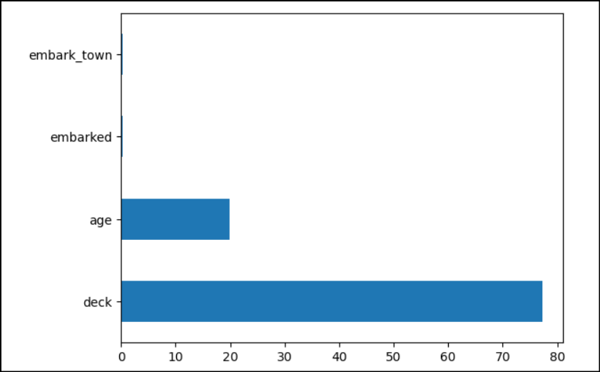
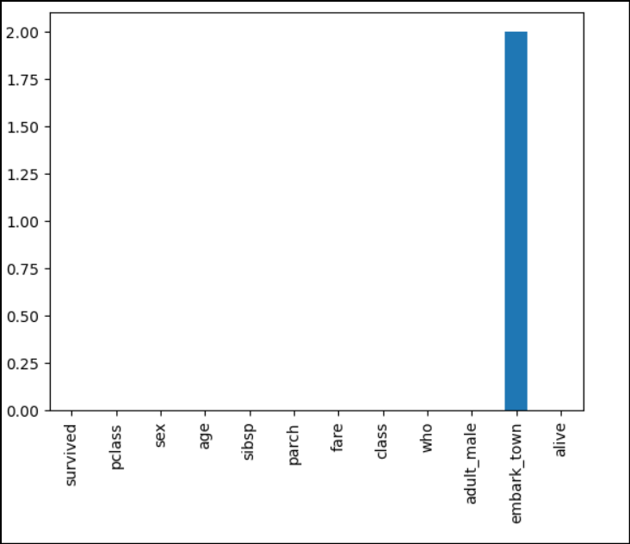
DATA CLEANING
Since deck has more than 70% of missing values and it has no catch over other columns, dropping the deck column.
The 'Age' column was successfully imputed, but the 'Embarked' and 'Embark-town' columns, despite having overlapping impacts, were not imputed due to their minimal missing values (0.22%).

Slide 10
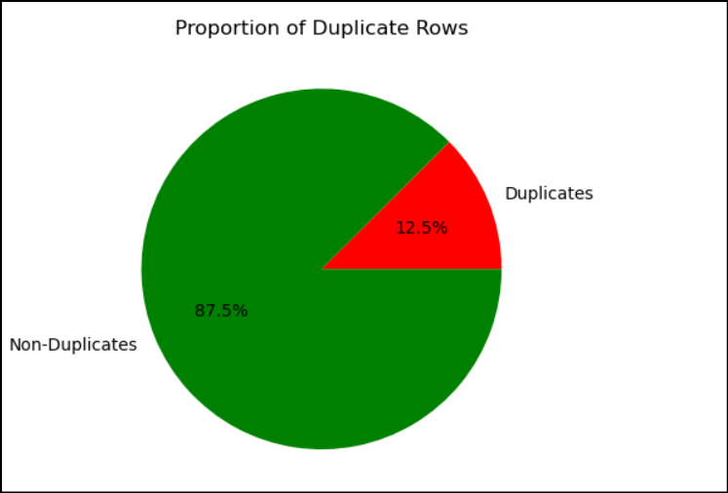
Analysis of Duplicated Rows Based on Passenger Attributes
Upon analyzing the Titanic dataset, it was found that there were 162 duplicated rows based on the combination of pclass, age, and sex.
However, after comparing these with the overall dataset, only 107 values were predicted as duplicates.
Considering that multiple passengers with similar attributes might be valid and reflective of the dataset’s real-world context, it was decided not to drop the duplicated rows.
This approach ensures that valuable patterns in the data, especially those related to similar passengers, are preserved for further analysis.

Slide 11
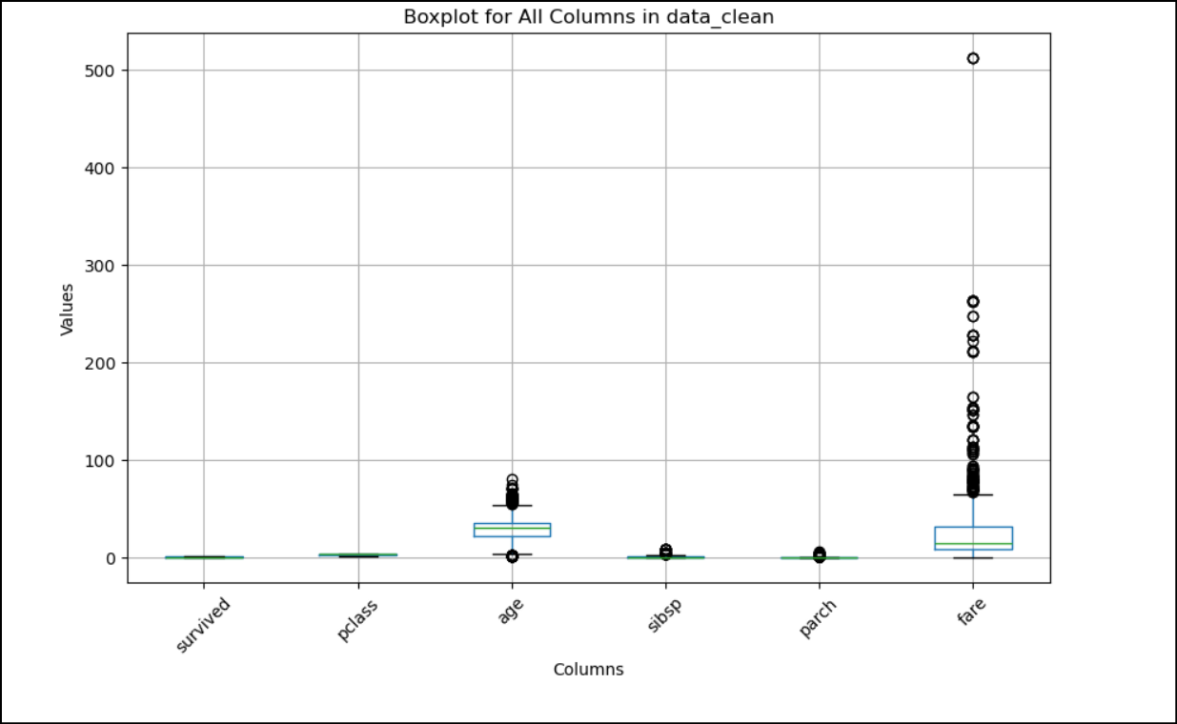
Detailed Analysis of Outliers in the Titanic Dataset
Age:
A few outliers represent individuals with ages much higher or lower than the majority.
This likely includes very young children or exceptionally old passengers.
SibSp (Siblings/Spouses Aboard):
Some outliers indicate passengers with an unusually high number of siblings or spouses aboard.
Parch (Parents/Children Aboard):
A small number of outliers reflect passengers traveling with an exceptionally high number of parents or children.
Fare:
The most significant outliers are observed here.
A few passengers paid extraordinarily high fares, potentially due to first-class tickets, private cabins, or special accommodations.

Slide 12
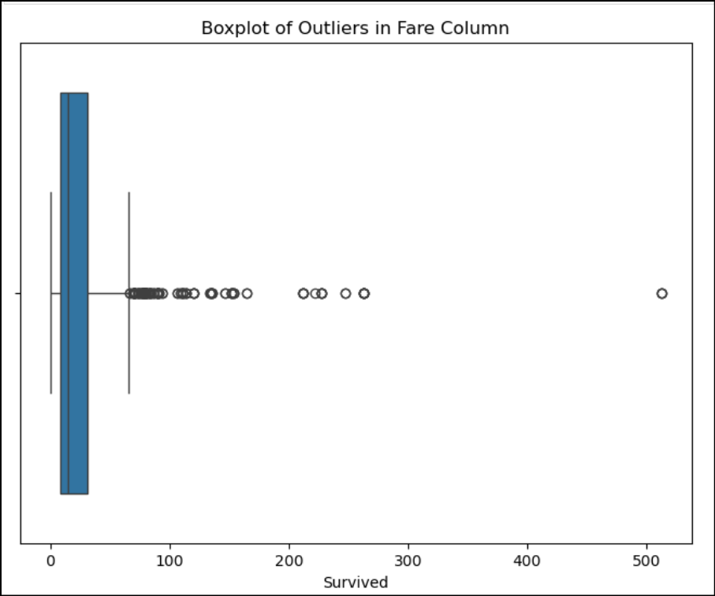
Outliers' detection
Analysis of Outliers in Age and Fare
The analysis identified outliers in both age and fare.
A particularly noticeable outlier was observed in the fare data, representing an exceptionally high fare value.
This extreme value significantly influences the overall fare distribution, making it a point of interest for further investigation.

Slide 13
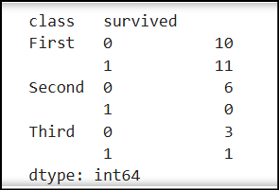
Impact of Outliers on First-Class Passenger Fare
The analysis revealed that first-class passengers exhibited 10 outliers in fare data, which significantly impacts the overall distribution of fares for this class.
These outliers contribute to the observation of higher fare values and noticeably skew the data towards the upper range.
This highlights the need for a closer examination of fare patterns within the first-class category

Slide 14
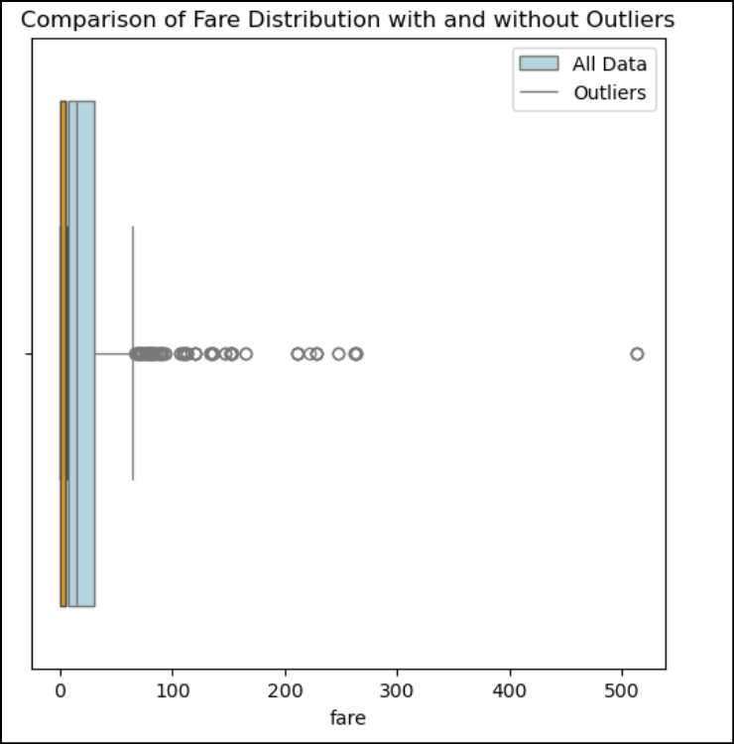
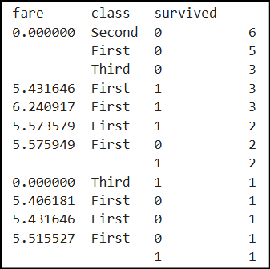
Outliers treatment

Slide 15
DATA VISUALIZATION

Slide 16
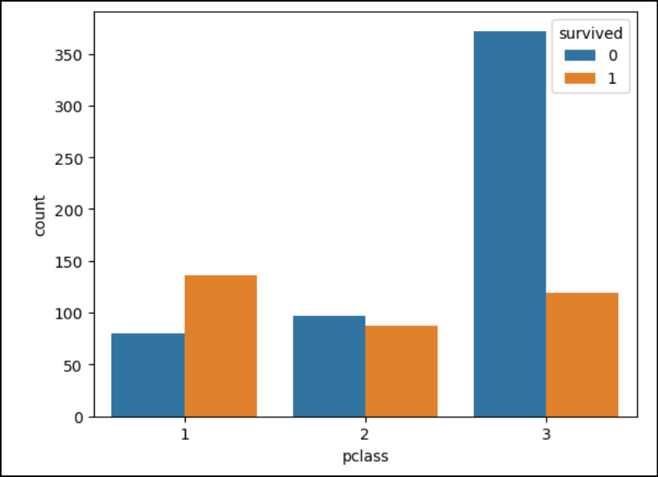
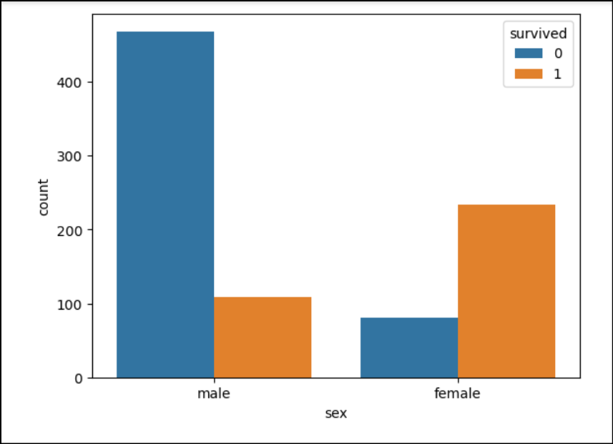
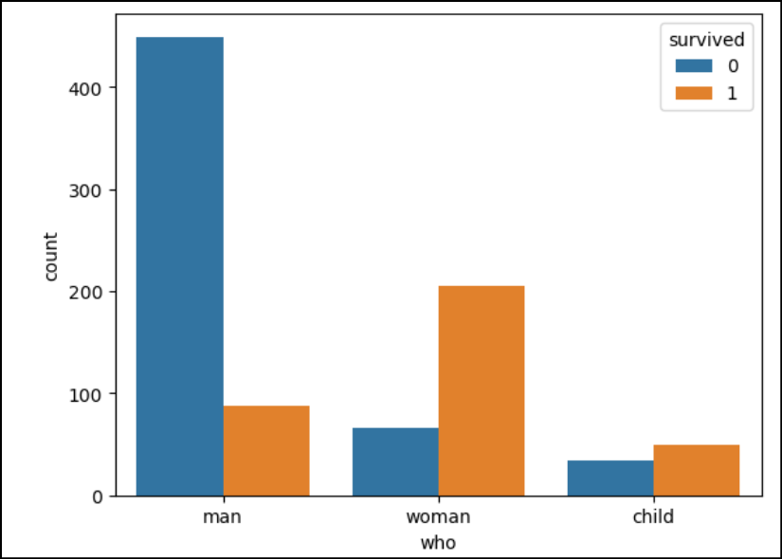
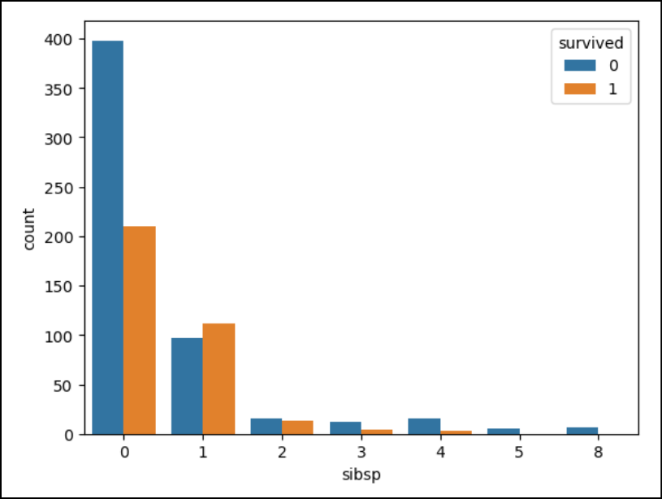
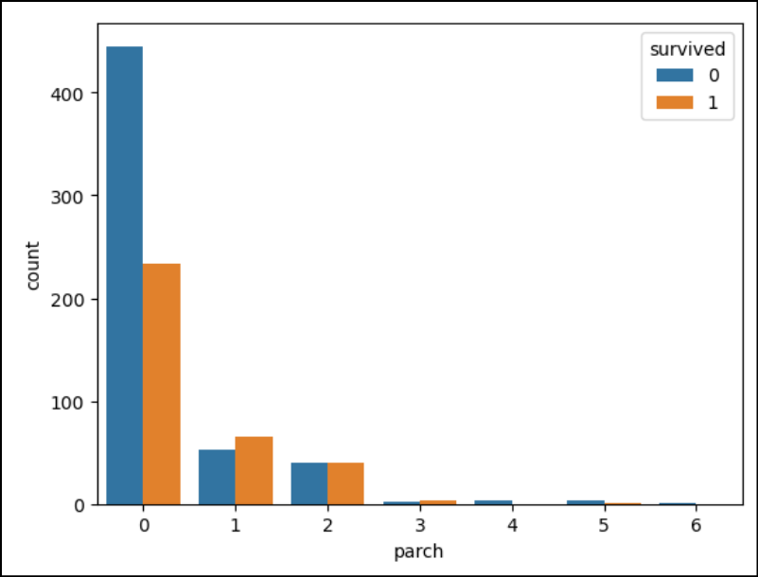
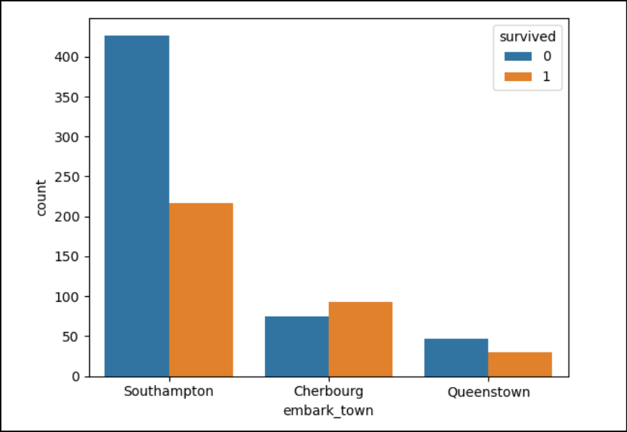
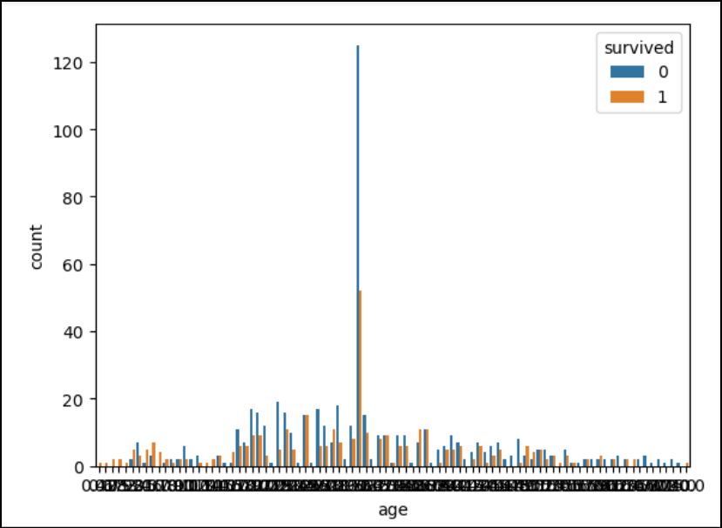
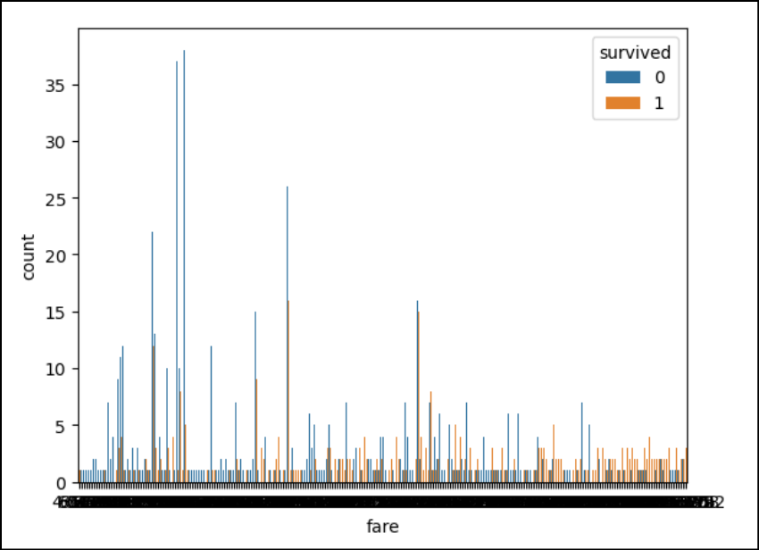
BIVARIATE ANALYSIS & INSIGHTS

Slide 17
1. Pclass vs Survived :
Observation:
First Class had the highest survival rate (more orange than blue).
Third Class had the lowest survival rate (dominantly blue).
Insight: Passengers in higher classes (1st) had a significantly better chance of survival compared to lower classes (3rd).
2. Sex vs Survived
Observation:
Females had a much higher survival rate (majority orange bars).
Males had a very low survival rate (mostly blue bars).
Insight: Survival rates were significantly higher for females compared to males, aligning with the "women and children first" evacuation policy.
3. Who vs Survived
Observation:
Women and children had higher survival rates.
Men had the lowest survival rate.
Insight: The "women and children first" policy is further confirmed here, as men had disproportionately lower survival chances.

Slide 18
4. SibSp vs Survived
Observation:
Passengers with 0 siblings/spouses had the highest count of non-survivors (blue bar).
Having 1-2 siblings/spouses slightly improved survival rates.
Larger numbers (5-8) of siblings/spouses correlate with very low survival chances.
Insight: Traveling alone or with very large groups reduced survival chances, while smaller family sizes (1-2) increased survival probability.
5. Parch vs Survived
Observation:
Most passengers had 0 parents/children and showed low survival rates.
Passengers with 1-2 parents/children had relatively higher survival rates.
Larger family sizes (3-6) again had very low survival rates.
Insight: Survival likelihood was highest for those with small family groups (1-2 dependents), while traveling alone or with very large families reduced chances.
6. Embark Town vs Survived
Observation:
Passengers from Cherbourg had higher survival rates.
Passengers from Southampton had a large count of non-survivors (blue dominates).
Passengers from Queenstown had lower survival rates overall.
Insight: Survival varied by embarkation point, with Cherbourg passengers having a notable advantage.

Slide 19
7. Age vs Survived
Observation:
A higher survival rate was visible among younger passengers (children).
Middle-aged and older passengers showed more non-survivors.
Insight: Children had better survival outcomes, consistent with the evacuation policy prioritizing "women and children."
8. Fare vs Survived
Observation:
Higher fares generally corresponded with higher survival rates (more orange spikes at higher fare ranges).
Passengers paying lower fares had a higher chance of not surviving.
Insight: Wealthier passengers (higher fare) had significantly better survival rates, aligning with their higher likelihood of being in First Class.

Slide 20
Overall Key Insights:
Pclass, Sex, and Family Size are critical determinants of survival.
First Class passengers, women, and those with small family groups had the highest chances of survival.
Embarkation Point: Passengers from Cherbourg had better survival rates.
Fare: Higher fares (wealthier passengers) were strongly associated with higher survival rates.
Age: Children had a clear advantage in survival compared to adults.

Slide 21
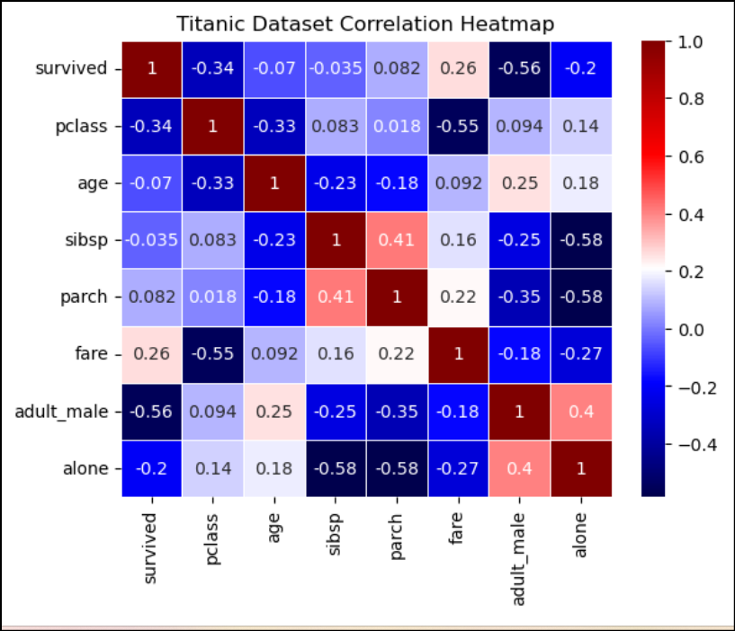
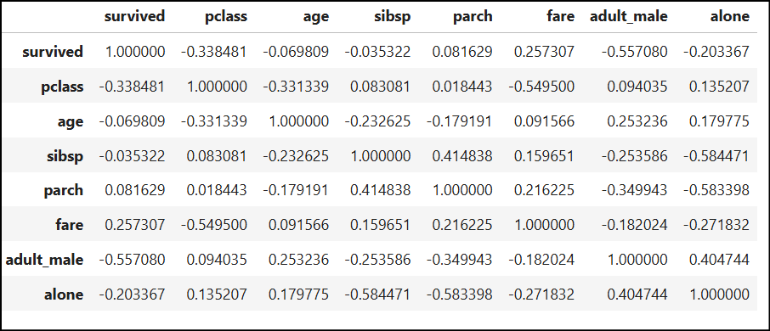
Numerical analysis- CORRELATION

Slide 22
Insights from Titanic Dataset Correlation Heatmap:
Survival and Key Variables:
Pclass: Strong negative correlation with survived (-0.34). Lower passenger classes (higher Pclass values) were less likely to survive.
Fare: Positive correlation with survived (0.26). Passengers who paid higher fares had a better chance of survival.
Adult Male: Strong negative correlation (-0.56) with survived, suggesting adult males were less likely to survive.
Alone: Weak negative correlation (-0.20) with survived. Being alone slightly reduced the survival chances.Relationships
Other Observations:
Variables like fare and Pclass play a significant role in survival outcomes.
Gender (adult_male) is one of the most influential factors in survival.
Summary:
Survival likelihood is higher for passengers in higher classes, who paid higher fares, and were not adult males.
Family relationships influence survival, with passengers traveling with family members faring better overall.
Age and gender show moderate to strong correlations with key survival indicators.
Relationships Among Independent Variables:
SibSp and Parch: Strong positive correlation (0.41) indicates passengers with more siblings/spouses (SibSp) also tended to have more parents/children aboard (Parch).
Fare and Pclass: Strong negative correlation (-0.55), which implies that passengers in lower classes (higher Pclass values) paid lower fares.
Alone and Parch/SibSp: Strong negative correlations (-0.58), indicating that passengers with family (siblings, spouses, parents, children) were not marked as "alone.“
Age and Pclass: Negative correlation (-0.33), indicating younger passengers were more likely to be in higher classes.
Age and SibSp/Parch: Weak negative correlations suggest older individuals were less likely to travel with family.

Slide 23
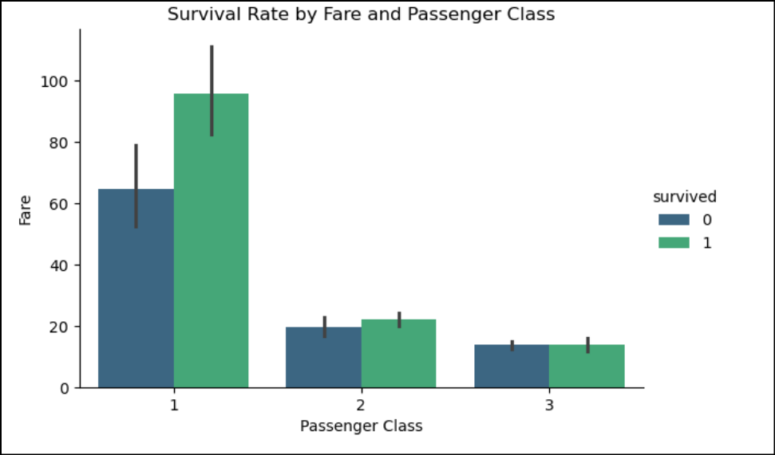
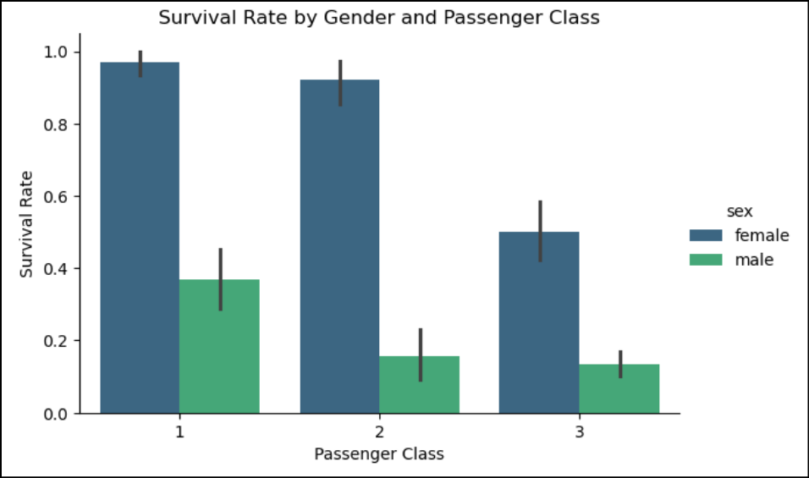
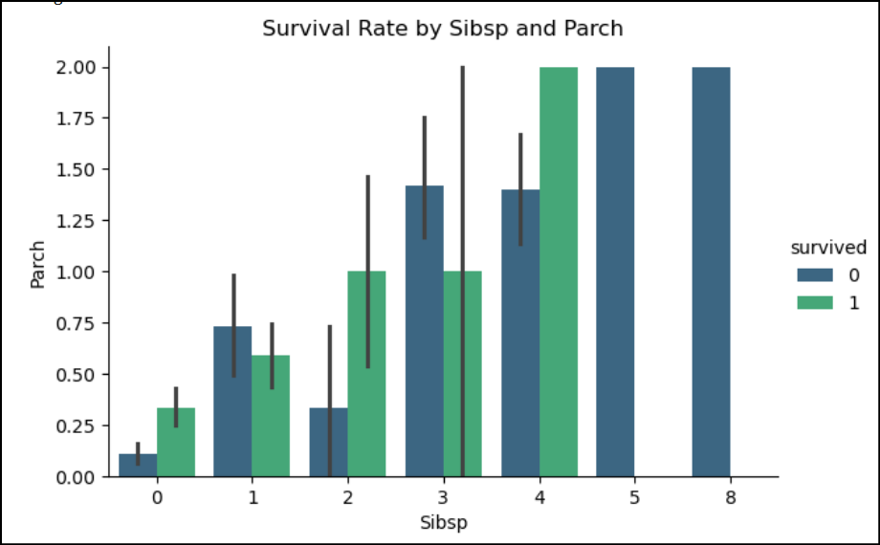
Insights from the Trivariate Analysis
Interplay Between Pclass, Fare, and Survival:
Passengers in First Class who paid higher fares had significantly better chances of survival.
This indicates not only class privilege but also access to better cabins located closer to lifeboats.
Conversely, Third Class passengers (low fares) were likely in lower ship decks, making evacuation more difficult
Combined Effect of Sex and Pclass:
First Class females had an extremely high survival rate, reinforcing the "women and children first" policy and class advantage.
Third Class males had the lowest survival rate, indicating a compounded disadvantage of both class and gender.
Family Dynamics (SibSp & Parch):
Larger families (5-8 members) struggled to survive as group mobility during an emergency was likely slower and chaotic.
* Traveling alone (no siblings, spouses, or dependents) also reduced survival chances, suggesting passengers with small family ties could rely on mutual support to escape.

Slide 24
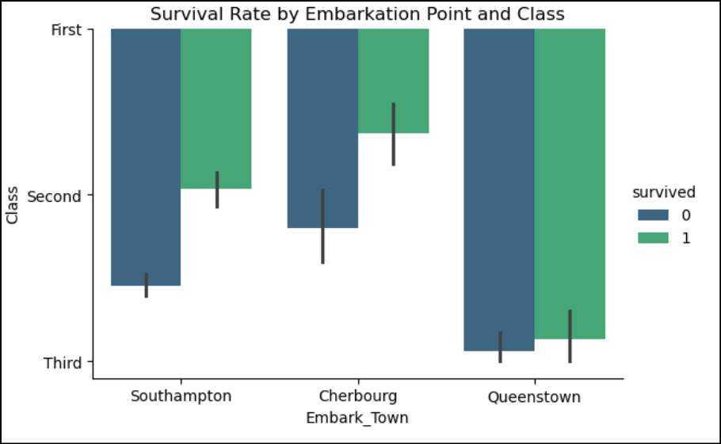
Survival Rates by Gender:
Females had much higher survival rates compared to males, especially in First and Second Class.
Impact of Passenger Class and Fare:
Survival rates were highest for First-Class passengers who paid higher fares.
Passengers in Third Class (lowest fare) had the poorest survival rates.
Combined Factors:
Gender + Class: Females in higher classes had survival advantages.
Fare + Class: Higher fares further reinforced the advantage for First-Class passengers.
Embark_town + Class: Southampton passengers dominated Third Class, leading to lower overall survival rates.
Embarkation Point & Class Influence:
Passengers from Cherbourg (where more First-Class passengers boarded) had better survival outcomes, suggesting that the embarkation point indirectly reflects social class distribution.
Southampton passengers dominated Third Class, leading to lower overall survival rates.

Slide 25
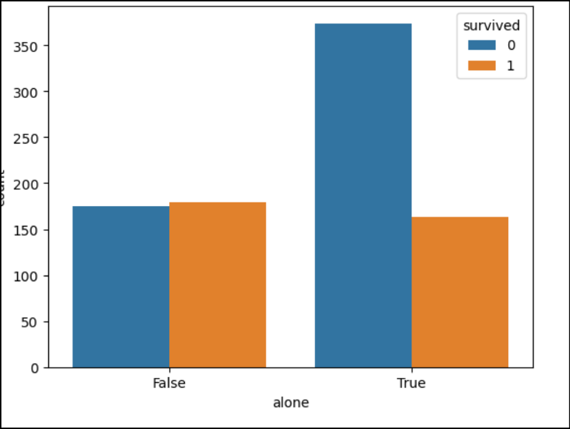
ADDITIONAL INSIGHTS
Age-Specific Insights:
Younger children had a survival advantage, particularly under 10 years old.
This suggests that age alone, combined with the "women and children first" policy, significantly influenced rescue efforts.
Survival rates for elderly passengers were low, indicating possible mobility challenges during evacuation.
Correlations Between Variables:
Fare vs Age: Younger passengers (likely children) from wealthier families (higher fares) were concentrated in First Class, further improving their survival chances
Fare vs SibSp/Parch: Passengers paying higher fares often traveled in smaller, manageable family groups, which improved survival odds.
Impact of "Alone" Status:
Being alone negatively impacted survival chances, especially among men.
This suggests that those traveling with family or dependents were prioritized for lifeboats.

Slide 26
Insights summary
Critical Determinants: Pclass, Sex, and Family Size were the most influential factors for survival.
Passenger Class: First Class passengers had significantly better survival rates than Third Class passengers.
Gender: Women had much higher survival rates than men.
Family Size: Smaller family groups (1-2 members) increased survival chances, while traveling alone or with large groups reduced survival rates.
Embarkation Point: Passengers from Cherbourg had better survival outcomes compared to Southampton and Queenstown.
Fare: Higher fares (wealthier passengers) were strongly associated with better survival rates.
Age: Children had a clear survival advantage compared to adults.
Survival was highly influenced by class, gender, and group size.
First-Class females and children enjoyed the highest survival rates, while Third-Class males suffered the most.
Family presence helped survival to a degree (1-2 family members), but large families faced challenges during evacuation.
Embarkation point indirectly reflects class distribution, impacting survival rates.
Mobility and accessibility played a crucial role, with lower-class and elderly passengers being at a disadvantage.

Slide 27
Thank you!!!
Eda REPORT BY LAVANYA R

